Slide 1
Recap on Reimagining Fundraising
Why participate?
We can create an environment of testing and experimenting / innovation within UNHCR
There was seed funding allocated to piloting (provided by Twilio)
Getting access to coaching & fundraising expertise for free
Learn from other front line innovation projects across the 12 participating INGOs
We asked Fundraising Directors across the 12 INGOs what challenges kept them up at night?
These are the challenges that they identified:
Challenge A: Engaging new audiences
Challenge B: Beyond traditional NGO fundraising models
Challenge C: New channels, new tools. Increasing relevance and value
Challenge D: Talent Revolution
Challenge E: Disrupt! Radical new ways to raise money
We received over 130 solutions. These solutions are the answers to (y)our challenges.

Slide 2
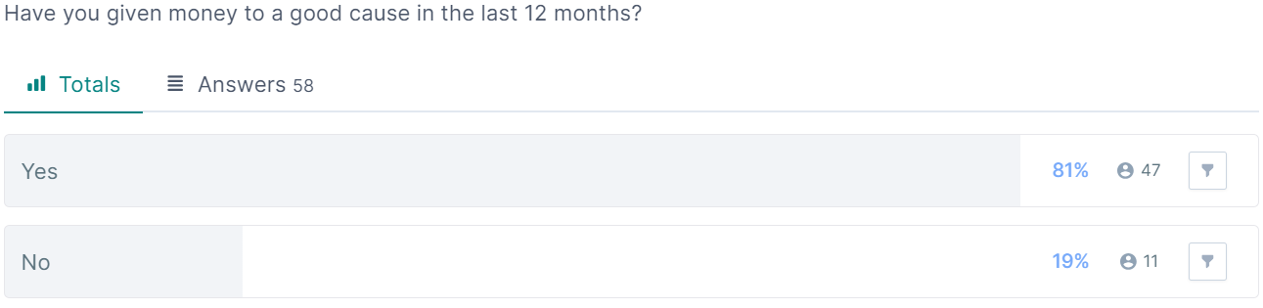
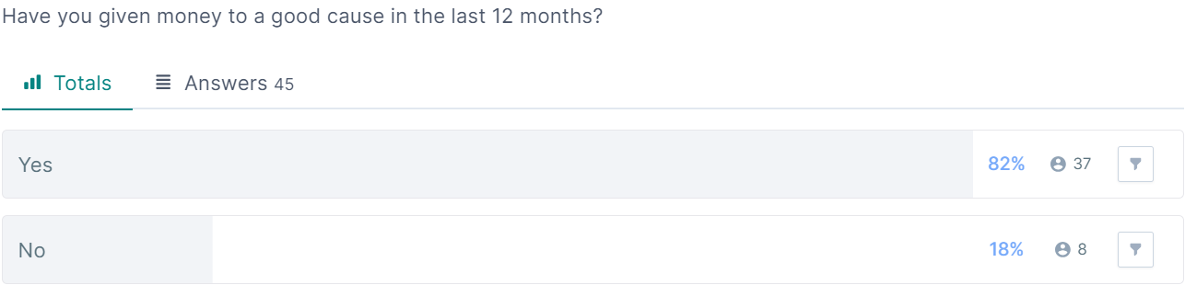
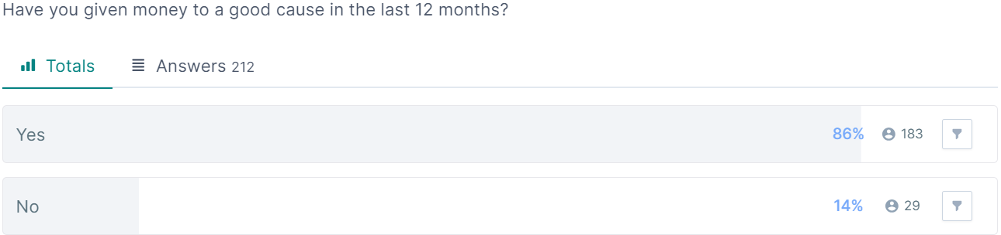
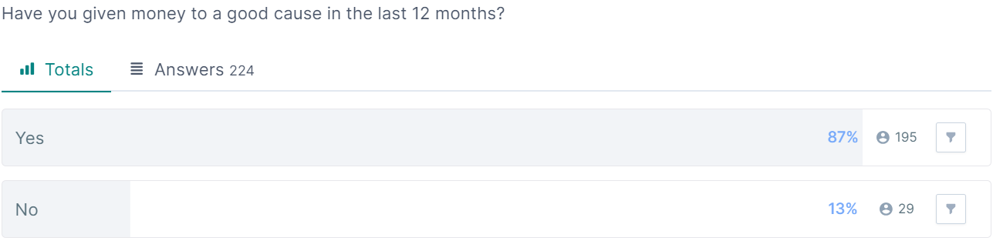
Q1
Singapore Gen Z (58)
Ireland Gen Z (45)
Singapore Millennials (212)
Ireland Millennials (224)

Slide 3
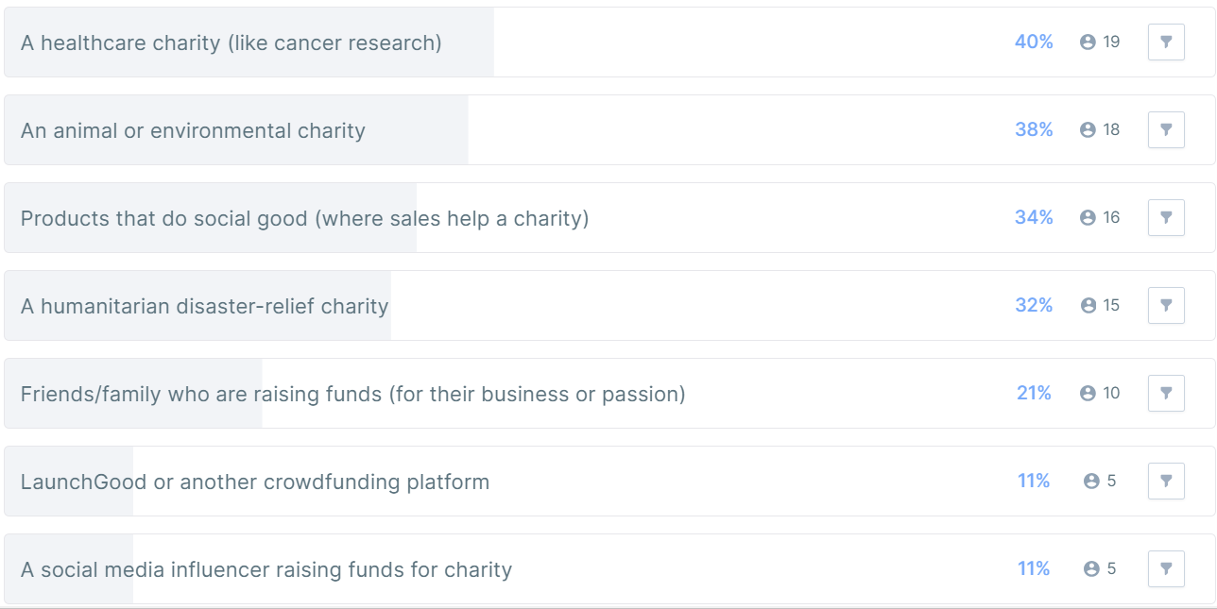
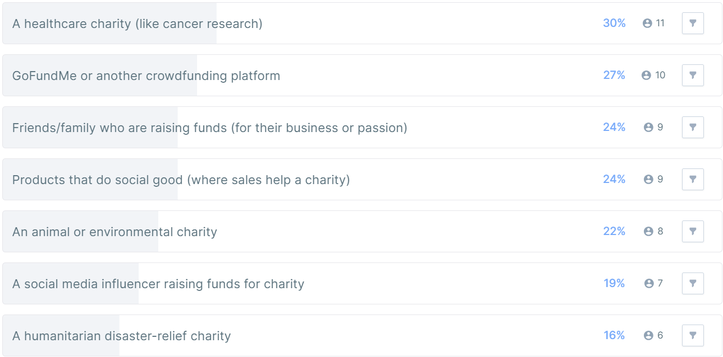
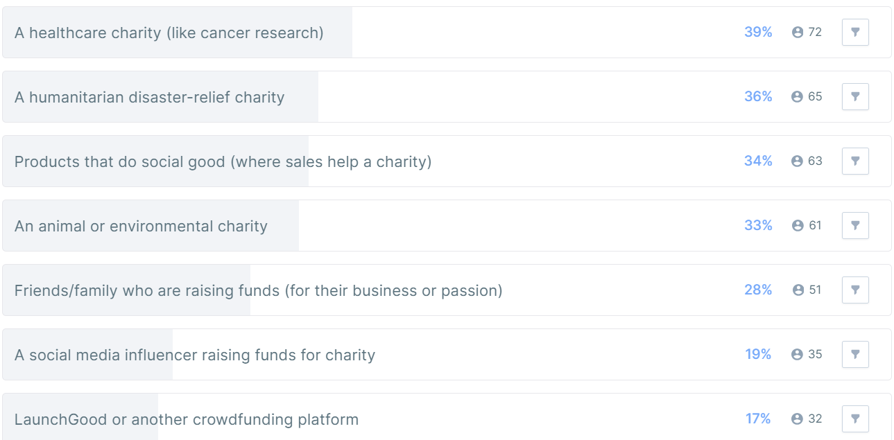
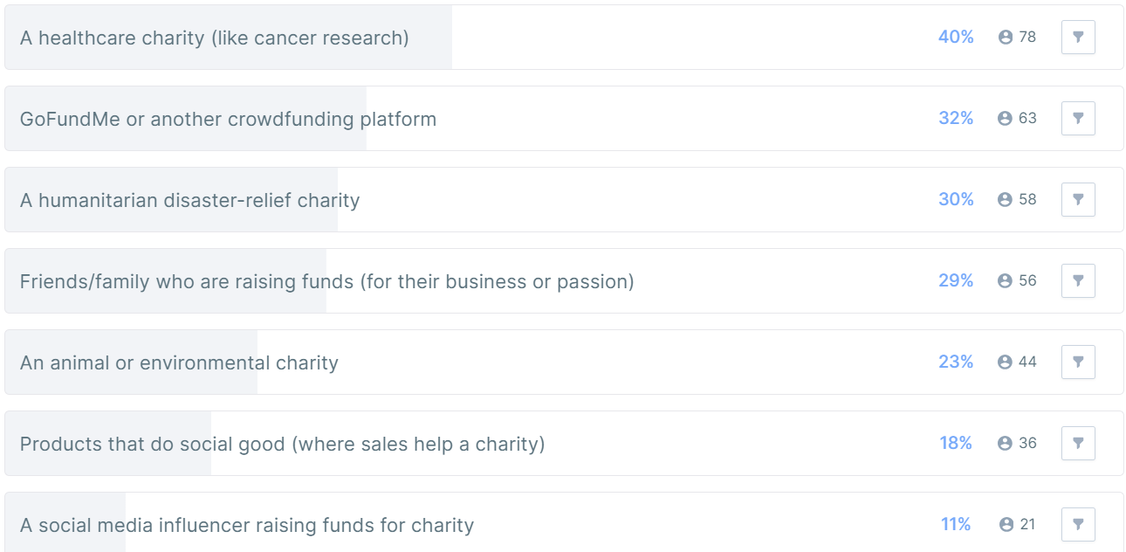
Q2: Was the donation to:
Singapore Gen Z (58)
Ireland Gen Z (45)
Singapore Millennials (212)
Ireland Millennials (224)

Slide 4
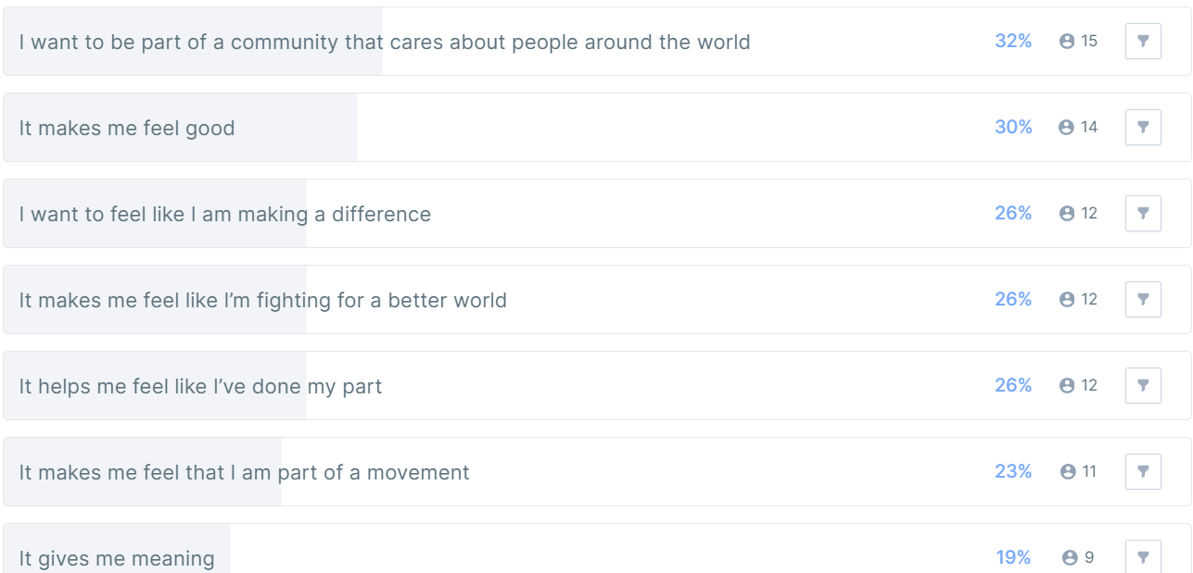
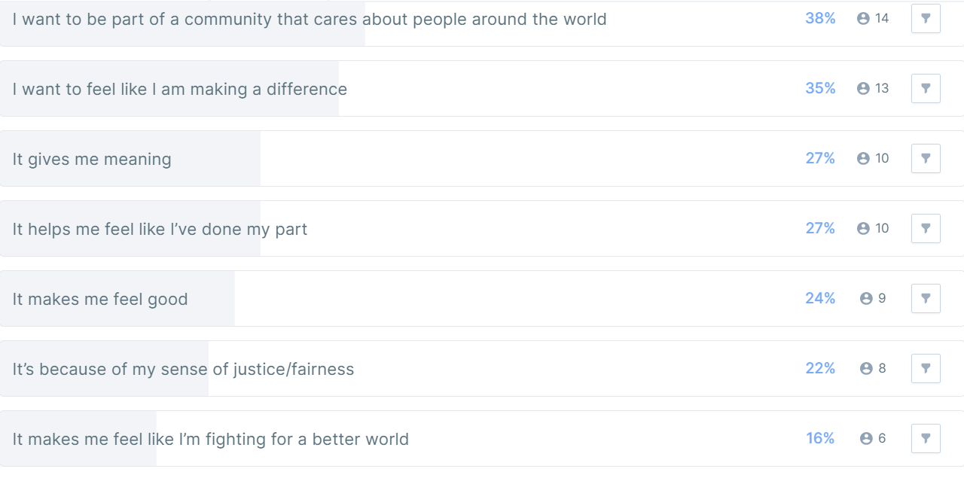
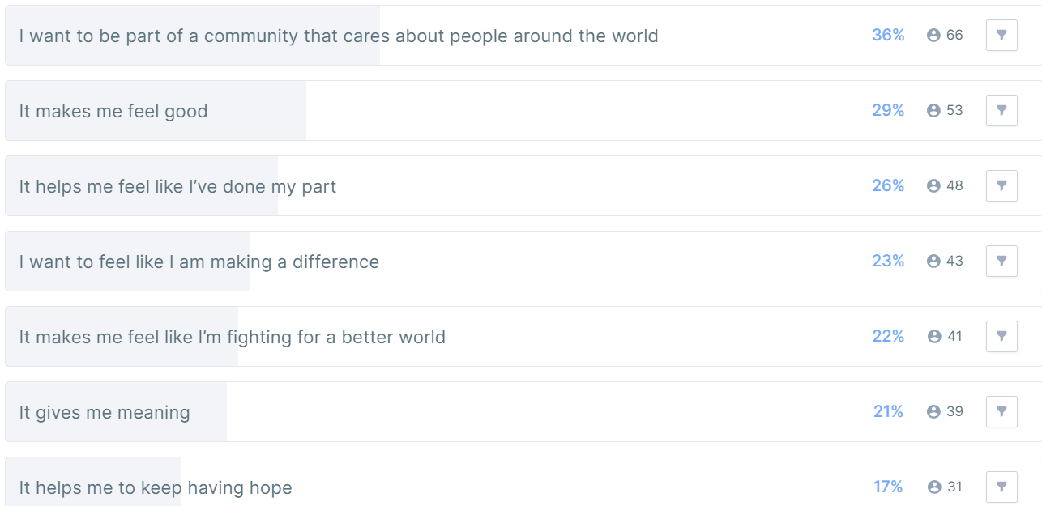
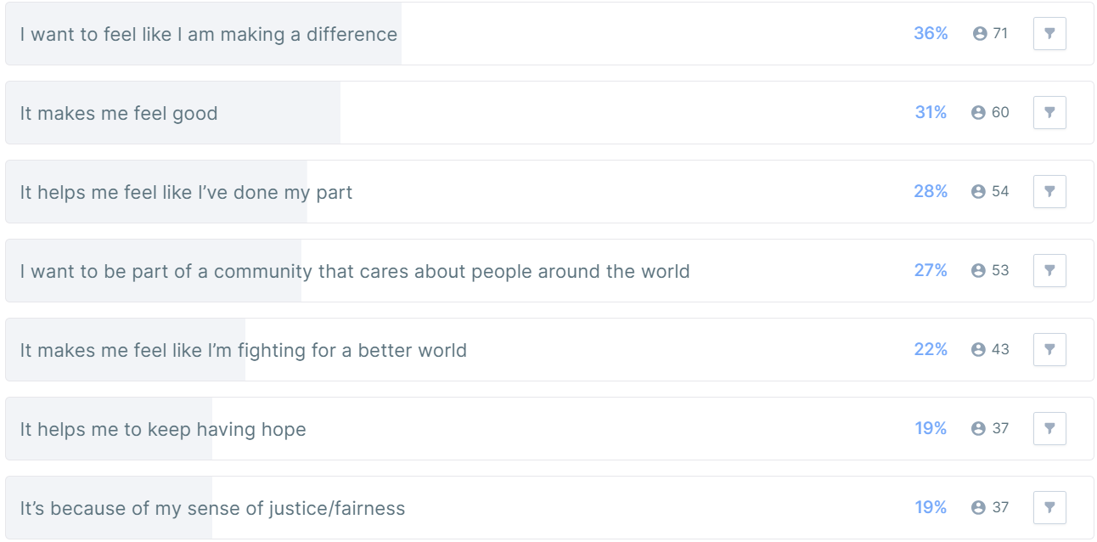
Q3: Which of the following best describes why you give to charity?
Singapore Gen Z (58)
Ireland Gen Z (45)
Singapore Millennials (212)
Ireland Millennials (224)

Slide 5
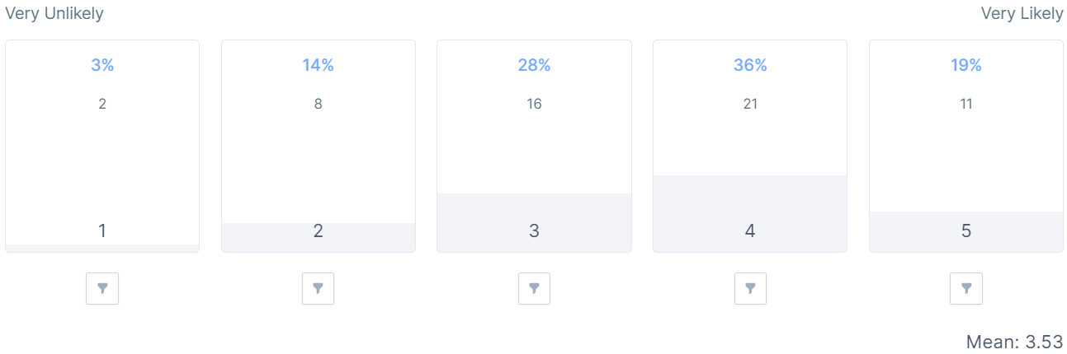
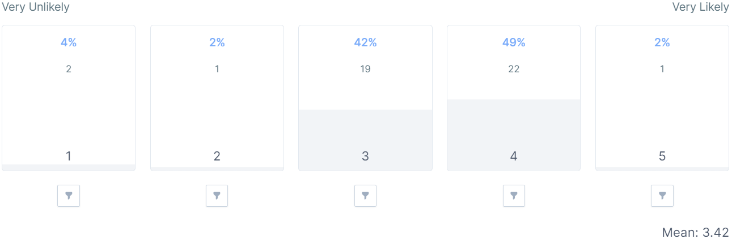
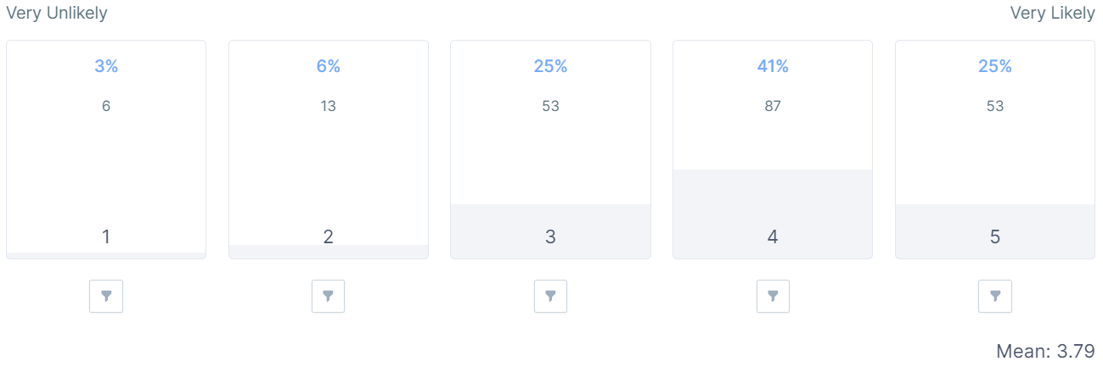
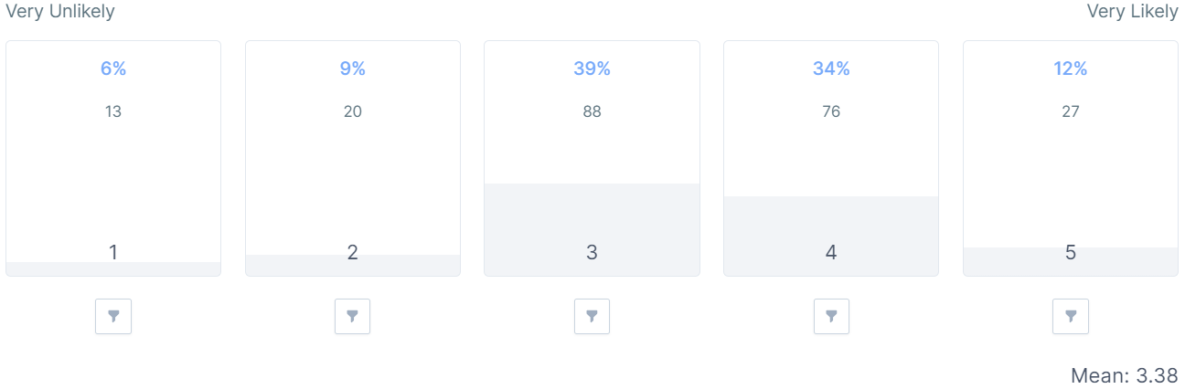
Q4: How likely are you to sign up to Givey?
Singapore Gen Z (58)
Ireland Gen Z (45)
Singapore Millennials (212)
Ireland Millennials (224)

Slide 6
Q5: Can you explain why you chose this option (Singapore)?
Singapore Gen Z (58)
Singapore Millennials (212)
Positive Impressions and Interest in the Platform (Approx. 24%)
Statements like "It seems like a good platform", "innovative way to increase donations", "Inspired", and others show positive interest and belief in the platform's potential.
2.Desire to Help and Make a Positive Impact (Approx. 22%)
Statements expressing a strong desire to help others and make a positive impact, such as "I love helping people", "I want to make life meaningful", and "I want to help people who are in need.
3.Financial Constraints and Limited Ability to Donate (Approx. 21%)
Statements indicating financial limitations, like "as a student, I am unable to afford donation", "no money to donate", and "Do not have extra income for charity".
4.Positive Feedback with Suggestions for Improvement (Approx. 18%)
Statements appreciating certain aspects of the platform, along with suggestions for improvement, such as "The app is attractive and looks professional. Most importantly, flexible donations." and "The poster could be more appealing, more details could be shared".
5.Apprehensions and Uncertainties (Approx. 15%)
Statements expressing uncertainty or concerns about the platform, such as "seems like a good app but I'm just not sure", "does not stand out", and "I do not know where my money is going to".
Desire to Help and Make a Positive Impact (Approx. 25%)
Statements expressing a strong desire to help others and contribute to meaningful causes. Examples: "Giving makes me feel good", "I feel good when I help others", "It's for a good cause".
2. Concerns and Need for More Information (Approx. 23%)
Statements expressing uncertainties, doubts, or a desire for more information about the platform. Examples: "Not very sure if it will be for legitimate causes", "Not sure if it's legit"
3. Positive Impressions and Satisfactory Experience (Approx. 18%)
Statements indicating a positive experience or satisfaction with the platform. Examples: "Very good I am satisfied", "Good social services", "amazing".
4. Financial Considerations and Constraints (Approx. 18%)
Statements related to financial situations, such as budget constraints or preferences for flexible donation amounts. Examples: "I always wanted to contribute 10% of my salary to charity...", "I want the flexibility to choose how much I want to donate a month", "No extra money to spare".
5. Appreciation for Platform's Features (Approx. 16%)
Statements expressing approval for specific features of the platform, such as flexible donations, monthly subscriptions, and ease of access. Examples: "I like the name of the apps. Giving something based on our ability", "Easy to access", "It's meaningful".

Slide 7
Q5: Can you explain why you chose this option (Ireland)?
Ireland Gen Z (45)
Ireland Millennials (224)
Desire to Make a Difference and Feel Empowered (Approx. 56%)
Statements expressing a strong desire to make a positive impact, feel empowered, and contribute to positive change in the world.
Sense of Justice/Fairness and Moral/Religious Duty (Approx. 31%)
Statements indicating a belief in fairness and justice, along with a sense of moral or religious duty to contribute to charitable causes.
Community and Identity (Approx. 25%)
Statements emphasizing the importance of being part of a community that cares about others and how charitable giving is linked to personal identity.
Avoiding Guilt and Feeling Good (Approx. 19%)
Statements expressing a desire to avoid feelings of guilt about personal situations and to experience positive emotions through charitable giving.
Meaning and Hope (Approx. 19%)
Statements highlighting the significance of finding meaning in charitable giving and maintaining a sense of hope for positive change.
Desire to Make a Difference and Feel Empowered (Approx. 41%)
Statements expressing a strong desire to make a positive impact, feel empowered, and contribute to positive change in the world.
Sense of Justice/Fairness and Moral/Religious Duty (Approx. 35%)
Statements indicating a belief in fairness and justice, along with a sense of moral or religious duty to contribute to charitable causes.
Community and Identity (Approx. 29%)
Statements emphasizing the importance of being part of a community that cares about others and how charitable giving is linked to personal identity.
Avoiding Guilt and Feeling Good (Approx. 22%)
Statements expressing a desire to avoid feelings of guilt about personal situations and to experience positive emotions through charitable giving.
Meaning and Hope (Approx. 21%)
Statements highlighting the significance of finding meaning in charitable giving and maintaining a sense of hope for positive change.

Slide 8
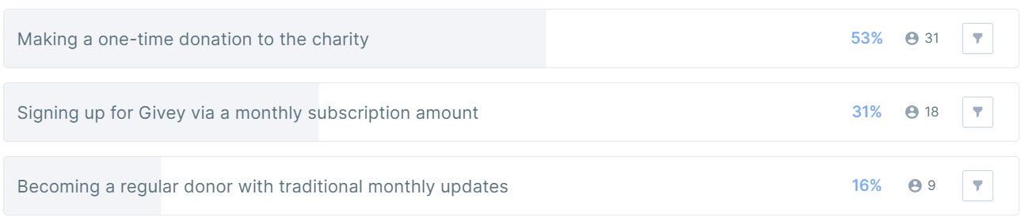
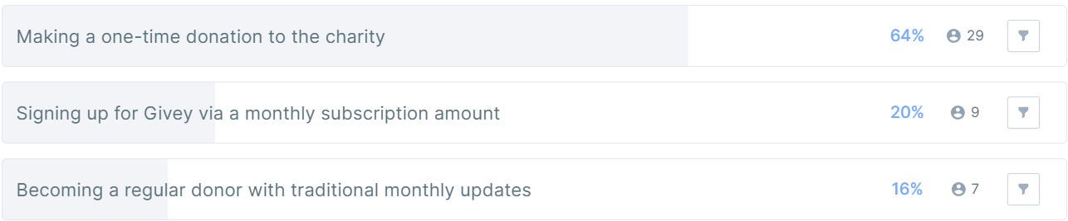
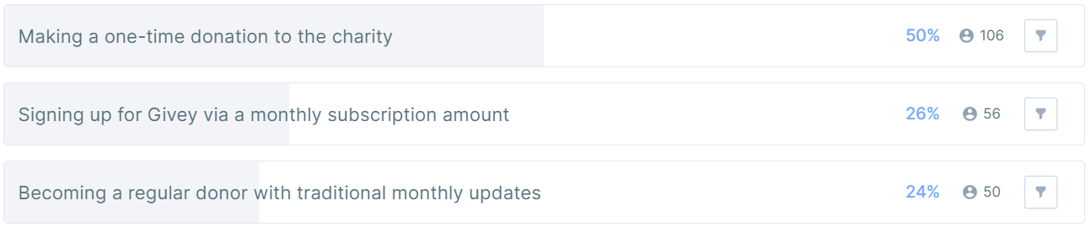
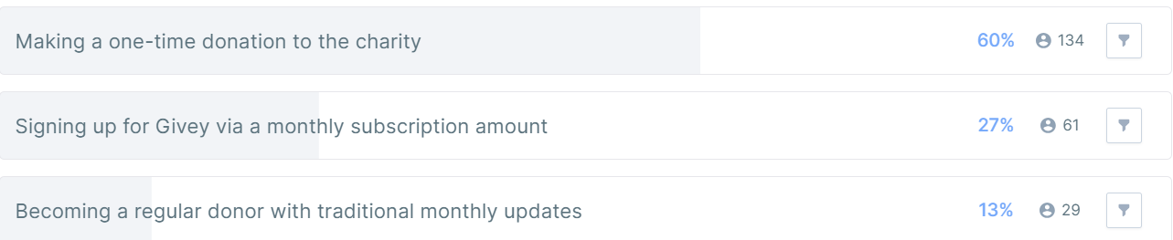
Q6: Pretend you’ve got $200, or $15 a month, to support the charity behind Givey. There are multiple ways to donate, how would you choose to donate based on the following options:
Singapore Gen Z (58)
Ireland Gen Z (45)
Singapore Millennials (212)
Ireland Millennials (224)

Slide 9
Q7: Can you explain why you chose this option (Singapore)?
Singapore Gen Z (31) from reason one-off
Singapore Millennials (106) from reason one-off
Convenience and Ease (Approx. 35%)
Statements indicating a preference for one-time donations due to the ease, convenience, and simplicity it offers. This includes not wanting to commit to monthly donations and finding it easier to manage.
Control and Flexibility (Approx. 27%)
Statements emphasizing the desire to have control over the donation amount and the ability to decide when and how much to give based on personal financial situations.
Desire for Impact and Empowerment (Approx. 20%)
Statements expressing a belief that a one-time donation can make a larger impact and lead to a greater sense of empowerment in helping others.
Preference for Assessing Situations (Approx. 18%)
Statements indicating a preference for evaluating situations and making donations based on immediate needs or specific circumstances rather than committing to regular monthly donations.
Convenience and Simplicity (Approx. 43%)
Statements indicating a preference for one-time donations due to the ease, simplicity, and convenience it offers.
Financial Considerations (Approx. 24%)
Statements expressing concerns about affordability and a preference for making a single donation that fits the individual's current financial situation.
Control and Transparency (Approx. 20%)
Statements emphasizing the desire to have full control over the donation amount and to know exactly how much is being given without the need for monthly tracking.
Personal Preference and Beliefs (Approx. 13%)
Statements reflecting personal preference, including a preference for giving in one go, feeling more comfortable with lump sum donations, or having a belief in sincerity.
.

Slide 10
Q7: Can you explain why you chose this option (Ireland)?
Ireland Gen Z (29) from reason one-off
Ireland Millennials (134) from reason one-off
Financial Flexibility and Control (Approx. 29%)
Statements expressing a preference for one-time donations due to the ability to have more control over when and how much to give, as well as the flexibility to donate based on personal financial circumstances.
Avoiding Commitment and Subscriptions (Approx. 26%)
Statements indicating a desire to avoid committing to regular monthly donations and a preference for not having to deal with subscriptions or direct debits.
Concerns About Variable Income (Approx. 12%)
Statements highlighting concerns about fluctuating income, making it uncertain if they would have enough to donate on a monthly basis, leading them to prefer one-time donations.
Lack of Familiarity or Trust in the Charity (Approx. 8%)
Statements suggesting a preference for one-time donations due to a lack of knowledge or familiarity with the organization, as well as a desire to research or assess the charity first.
Other Reasons (Approx. 25%)
Statements expressing various other reasons for preferring one-time donations, such as ease, simplicity, personal preference, security concerns, or the belief that one large donation would have a bigger impact.
Financial Circumstances and Income Variability (Approx. 24%)
Statements indicating that the variability of income and expenses, as well as uncertainty about future financial circumstances, make one-time donations a more suitable option.
Ease and Simplicity (Approx. 22%)
Statements expressing a preference for one-time donations because they are seen as easier, simpler, and more straightforward compared to committing to regular monthly donations.
Control and Flexibility (Approx. 20%)
Statements emphasizing the desire for control over the donation amount and the ability to choose when to donate based on personal circumstances.
Financial Limitations (Approx. 17%)
Statements indicating that financial constraints or limitations prevent individuals from committing to regular monthly donations, making one-time donations a more feasible option.
.

Slide 11
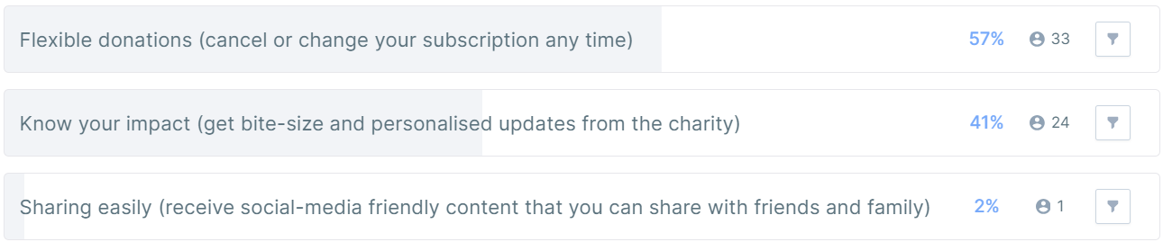
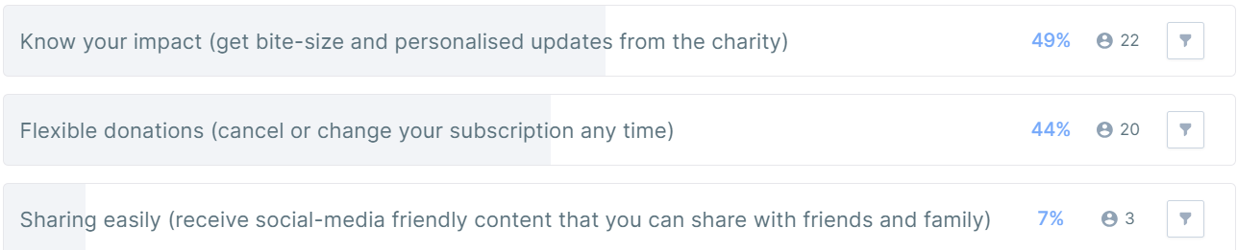
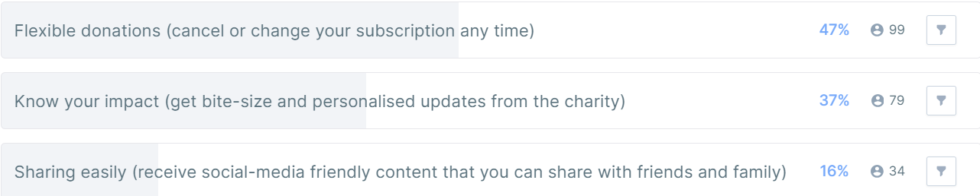
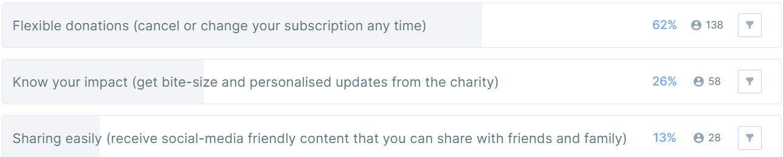
Q8: Which of these Givey features is most important or most interesting to you?
Singapore Gen Z (58)
Ireland Gen Z (45)
Singapore Millennials (212)
Ireland Millennials (224)

Slide 12
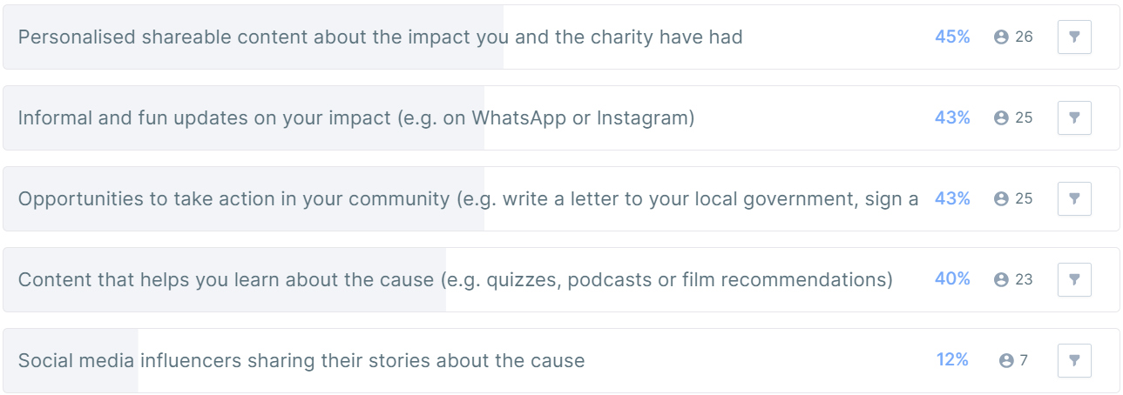
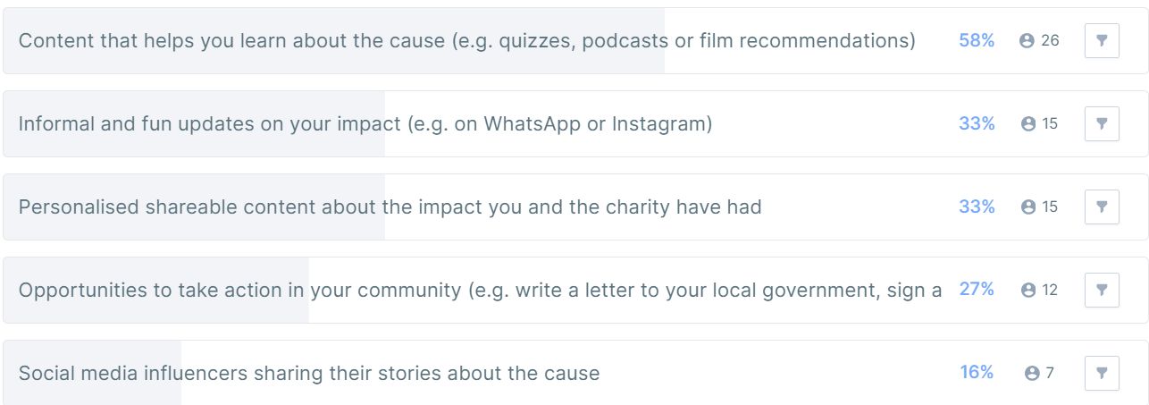
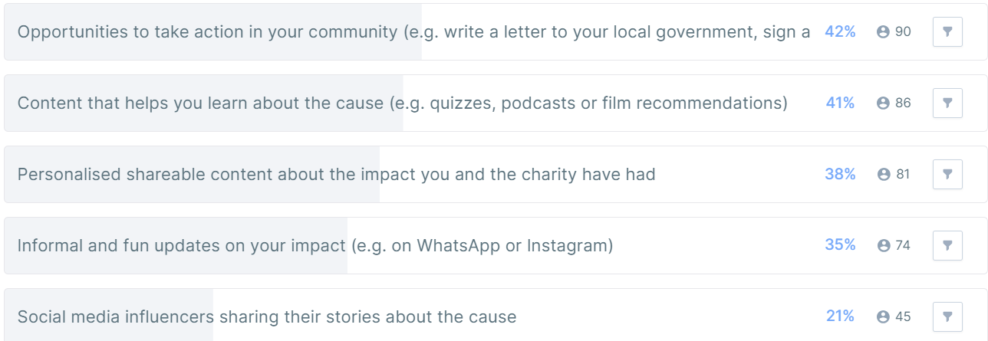
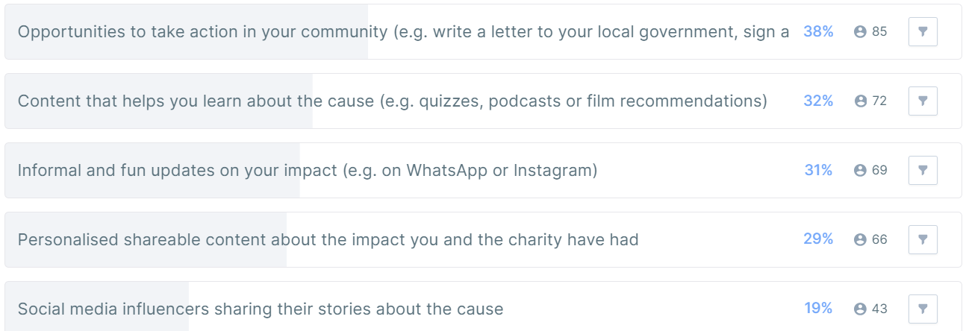
Q9: As part of your Givey subscription, you will get access to certain features. Which are most important to you? Pick your top 2?
Singapore Gen Z (58)
Ireland Gen Z (45)
Singapore Millennials (212)
Ireland Millennials (224)

